Slide 1
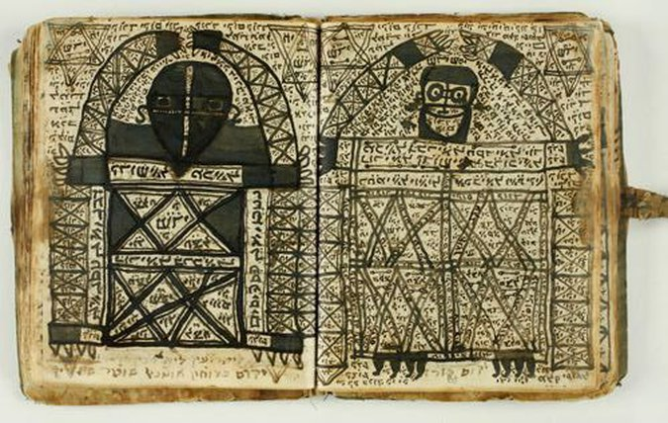
The Kabbalah
Manuscript of Practical Kabbalah depicting angels. From Morocco, 1925.
Dr. Stephanie Spoto
4/11/2019
Monterey Peninsula College
Gentrain 406: The Medieval Renaissance and the High Middle Ages

Slide 2
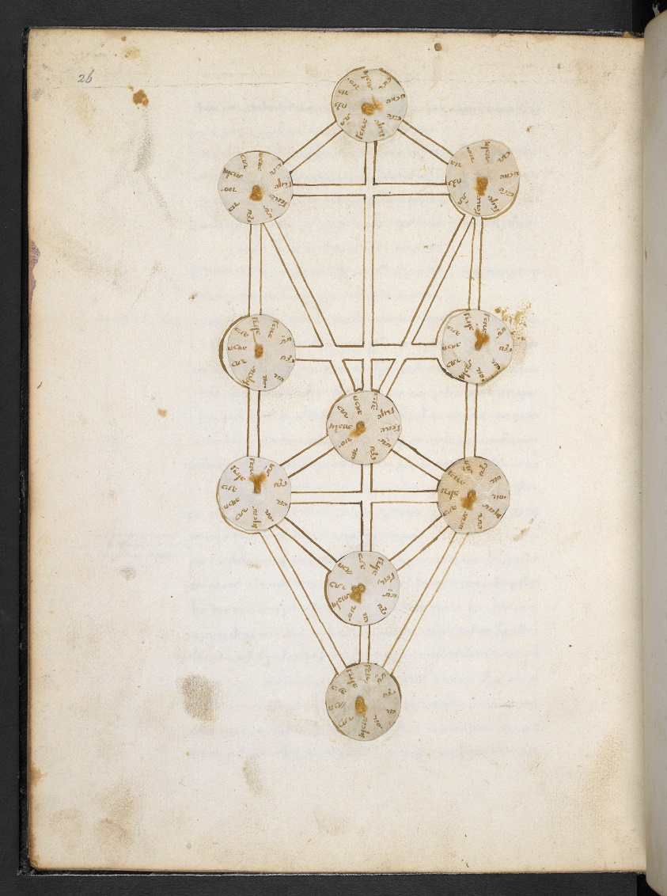
Overview of the Kabbalah
Jewish Kabbalah set of esoteric teachings meant to explain the relationship between God, the unchanging, eternal, and mysterious Ein Sof (אֵין סוֹף “The Infinite”) and the mortal and finite universe (God's creation).
The foundation of mystical religious interpretations within Judaism
Kabbalah (Hebrew: קַבָּלָה, literally “reception, tradition” or “correspondence”) is an esoteric method, discipline, and school of thought of Judaism.
Definition of Kabbalah changes depending on the tradition and aims of followers
Initially an integral part of mystical Judaism, it was later adopted into Western esotericism (Christian Cabala and Hermetic Qabalah).

Slide 3
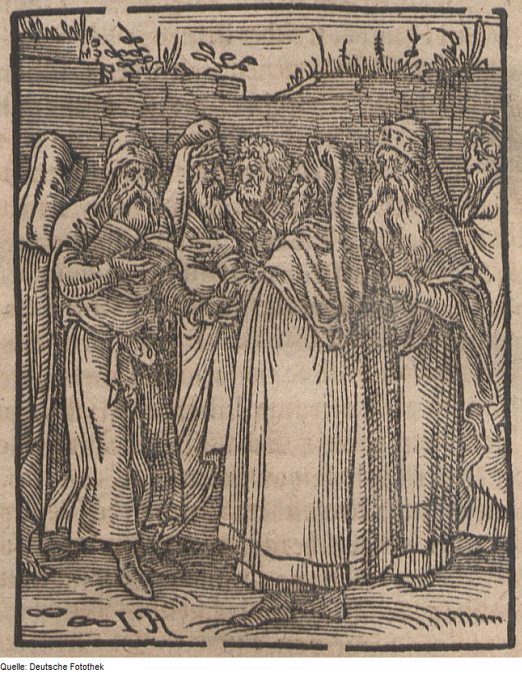
Transmission of sacred ideas
Kabbalists developed their own transmission of sacred texts → use classical Jewish scripture to explain its mystical teachings
Aim to explore the hidden meaning of the Torah and traditional rabbinic literature like the Mishna.
One fundamental Kabbalistic text is the 13th century Zohar
Jewish Kabbalists portrayed in 1641; woodcut on paper, Saxon University Library, Dresden.

Slide 4
The Zohar
Written in obscure style of Aramaic (common language of Israel 500 BCE – 70 CE).
However, the language is not very sophisticated which leads scholars to think that this was not the native language of the writer
First appeared in 13th century Spain
Published by a Jewish writer named Moses de León → ascribed the work to Shimon bar Yochai ("Rashbi")
Rashbi: rabbi of the 2nd century Roman persecution → hid in a cave for thirteen years studying the Torah and was inspired by the Prophet Elijah to write the Zohar.

Slide 5
Concealed and Revealed God Envisioned two aspects of God
God in essence
God in manifestation
God in essence, unknowable, absolutely transcendent, limitless divine simplicity
Ein/Ayn Sof ( אין סוף “the infinite/endless”, literally “there is no end”). →
Negative Theology: nothing of the En Sof can be grasped
God in manifestation, the revealed persona of God through which he creates and sustains and relates to humankind.
Accessible to human perception
Interacting throughout spiritual and physical existence, reveal the divine immanently, and are bound up in the life of people.
These two aspects are not contradictory but complement one another, emanations revealing the concealed mystery from within the Godhead.

Slide 6
Origin of Evil
Considered major concern in the Kabbalah
Some Kabbalists considered “evil” as a “quality of God” → negativity enters into the “essence of the Absolute” → needs evil to “be what it is”
Medieval Kabbalism: evil as a demonic parallel to the holy, called the Sitra Achra (the "Other Side"), and the Kelipot/Qliphoth (the "Shells/Husks") that cover and conceal the holy, are nurtured from it, and yet also protect it by limiting its revelation.
Gersholm Scholem: this element of the Spanish Kabbalah is a "Jewish gnostic" motif, in the sense of dual powers in the divine realm of manifestation.
Cantoni, Piero (2006). "Demonology and Praxis of Exorcism and of the Liberation Prayers", in “Fides Catholica 1"

Slide 7
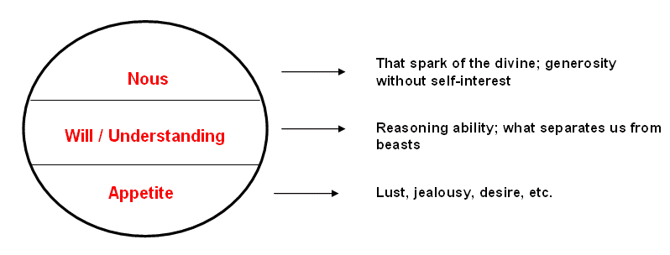
Three Levels of the Soul compared with Plato’s Tripartite Soul
Nefesh (the lower part, or "animal part", of the soul). It is linked to instincts and bodily cravings. This part of the soul is provided at birth. Found in all humans → enters the soul at birth. Source of physical/psychological nature.
Ruach (the middle soul, the "spirit“). It contains the moral virtues and the ability to distinguish between good and evil. Not from birth, but developed over time.
Neshamah (the higher soul, or "super-soul“). This separates man from all other life-forms. It is related to the intellect and allows man to enjoy and benefit from the afterlife. It allows one to have some awareness of the existence and presence of God. Developed over time.

Slide 8
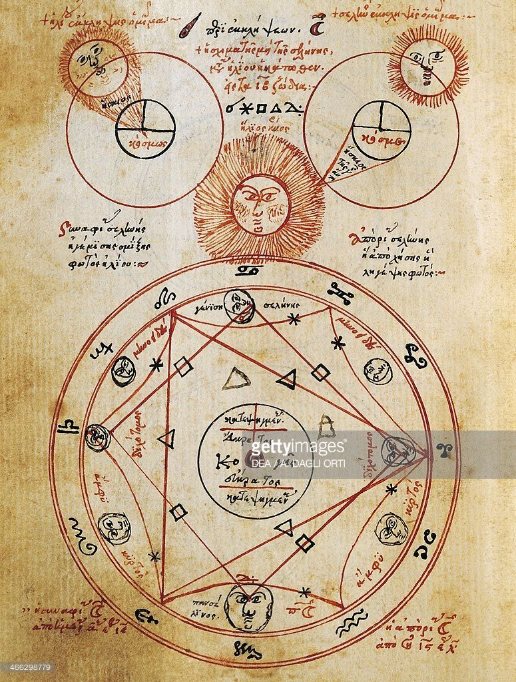
Higher levels of the soul
The Raaya Meheimna (a section of related teachings spread throughout the Zohar) discusses fourth and fifth parts of the human soul, the chayyah and yehidah/yechidah (first mentioned in the Midrash Rabbah).
Gershom Scholem: "were considered to represent the sublimest levels of intuitive cognition, and to be within the grasp of only a few chosen individuals".
The Chayyah and the Yechidah do not enter into the body like the other three → received less attention in other sections of the Zohar.
Chayyah: The part of the soul that allows one to have an awareness of the divine life force itself.
Yehidah: The highest plane of the soul, in which one can achieve as full a union with God as is possible.
Influence of the sun, moon and stars on reading the signs of the Kabbalah, miniature from a Kabbalistic treatise, Greek manuscript. 16th century.

Slide 9
Reincarnation
Reincarnation, the transmigration of the soul after death, was introduced into Judaism as a central esoteric tenet of Kabbalah from the Medieval period onwards, called Gilgul neshamot ("cycles of the soul").
The concept does not appear overtly in the Hebrew Bible or classic rabbinic literature, and was rejected by various Medieval Jewish philosophers.
However, the Kabbalists explained a number of scriptural passages in reference to Gilgulim.
Entered Jewish thought primarily as a literary motif

Slide 10
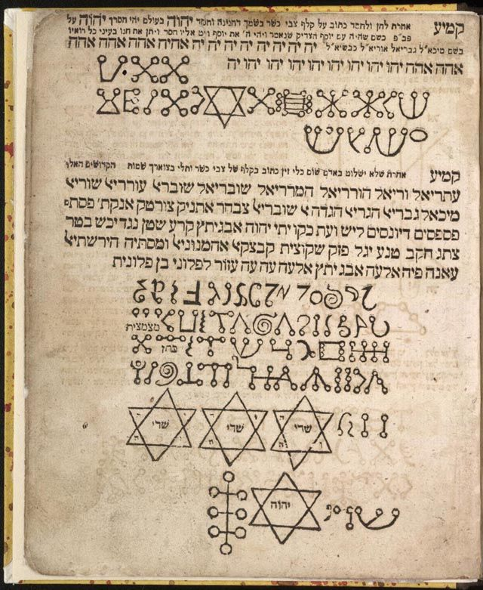
Hebrew Language as Divine
God enacted Creation through the Hebrew language and through the Torah
This already existed in Midrashic traditions, but Kabbalistic writings turned this into a full linguistic mysticism.
Every Hebrew letter, word, number, even accent on words of the Hebrew Bible contain esoteric meanings, describing the spiritual dimensions within exoteric ideas
Names of God in Judaism have further prominence → fluidity of meaning turns the whole Torah into a Divine name.
Hebrew name of things is the channel of their lifeforce → "holiness" and "mitzvot" embody ontological Divine immanence, as God can be known in manifestation as well as transcendence.
Sefer Raziel HaMalakh, (“Book of Raziel the Angel”), medieval Kabbalistic grimoire

